Slide 1
CS4416 Database Systems
Lecturer: Nikola S. Nikolov (Nik)
E-mail: nikola.nikolov@ul.ie
Lab Assistants: Josh McGiff, Salma Mekaoui, Toheeb Jimoh
Labs start in week 1
Tutorials start in week 2

Slide 2

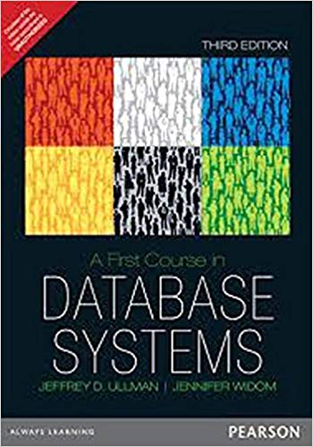


Module Material
Textbooks (relational databases):
J. D. Ullman and J. Widom, A First Course in Database Systems, 4th edition, Pearson, 2014
Thomas Connolly and Carolyn Begg, Database Systems, 6th ed., Pearson, 2014
Module website: https://learn.ul.ie/
Labs: MySQL/MariaDB with phpMyAdmin. Work from home/own computer by installing XAMPP: https://www.apachefriends.org/.

Slide 3
Assessment Instruments
Midterm Exam (week 6, TBC): 15%
Project: 20% (groups of 4-5 students)
Formal specifications will be announced by week 6
Deadline: Friday, week 12
-5% penalty for late submissions
No submissions will be accepted after the final exam
Final exam: 65%
Repeat by an individual project: 100%

Slide 4
Grading Scheme
Mark Grade QCA
80 A1 4.00
72 A2 3.60
64 B1 3.20
60 B2 3.00
56 B3 2.80
52 C1 2.60
48 C2 2.40
40 C3 2.00
35 D1 1.60
30 D2 1.20
<30 F 0.00

